Slide 1
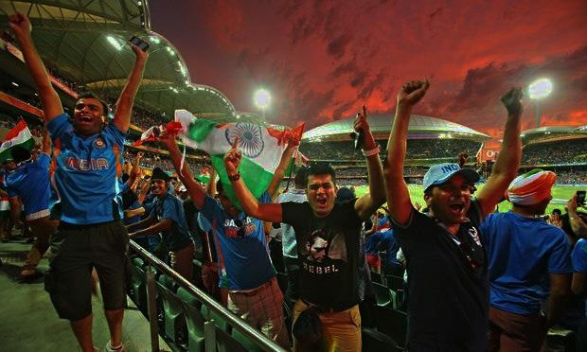
INDIA
A billion heartbeats...
A Journey to history…

Slide 2
Sport:
Sport (or sports) is all forms of usually competitive physical activity which, through casual or organised participation, aim to use, maintain or improve physical ability and skills while providing entertainment to participants, and in some cases, spectators.
~ physical activity ~
Game:
A game is structured playing, usually undertaken for enjoyment and sometimes used as an educational tool.
~ non-physical activity ~
A number of competitive, but non-physical activities claim recognition as mind sports, like Chess, Bridge (Game involving playing cards).

Slide 3
Oldest
Sprinting (Competitive Running) and Wrestling is the oldest sports in the world.
Cave paintings found in the Lascaux caves in France traces sprinting and wrestling to 17,300 years ago.
The Royal Game of Ur, Senet, and Mancala are some of the oldest known games dating back to ~3100 B.C.E.

Slide 4
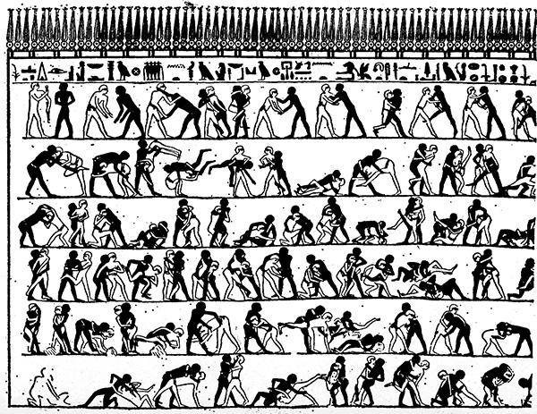
An Egyptian burial chamber mural, from the tomb of Khnumhotep and Niankhkhnum dating to around ~2400 B.C.E., showing wrestlers in action.

Slide 5
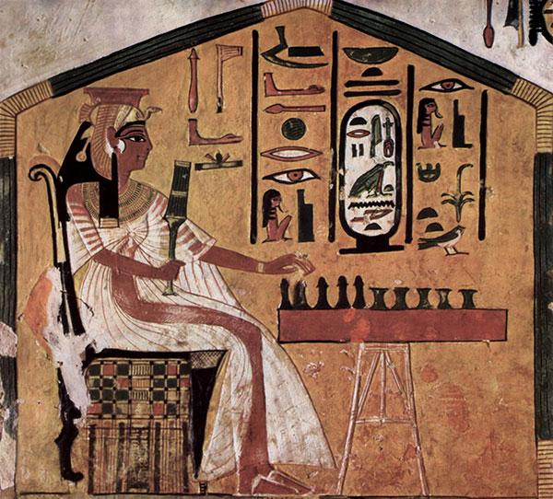
Painting in tomb of Egyptian Queen Nefertari (~1295 – 1255 B.C.E.) playing Senet.

Slide 6
Bharat and Sports.

Slide 7
Ancient India
All about the development of the physique and for the art of offence and defence.
Indus valley civilization (~3300 B.C.E. to ~1700 B.C.E.):
Swimming.
Marbles, balls and dice games.
Hunting
Punching / Boxing.

Slide 8
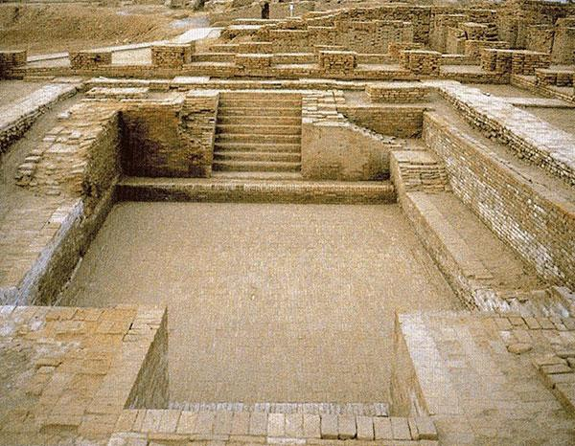
Great Bath (Mohenjo-daro, Indus Valley Civilization) or the Modern day swimming pool?

Slide 9
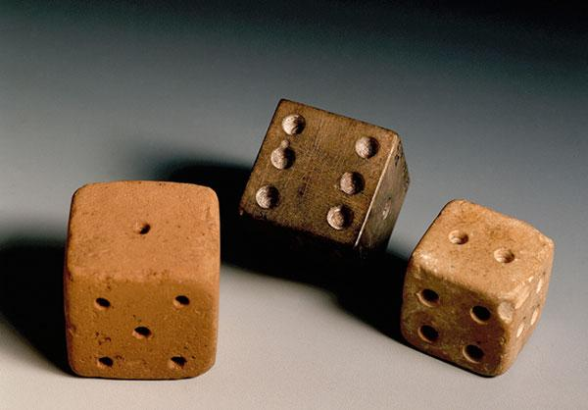
Dice from before 2000 B.C.E., made from stone and used in games.

Slide 10
Vedic period (~1750 B.C.E. to ~500 B.C.E.):
Chariot Racing
Horse Racing
Dicing
Notes:
B.C.E - Before Common Era

Slide 11
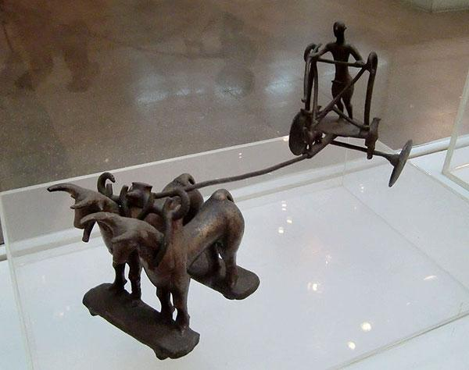
Coach driver riding horse from late Indus Valley Civilization (~2000 B.C.E.)

Slide 12
Chess
It is believed Chess originated from India, proven to be from the period of Gupta Empire (~320 C.E. - ~550 C.E.)
Earliest name known to be Chatur-Anga. The name means “Four Parts” or “4 branches of Army” (as per ancient belief).
The name comes from a battle formation mentioned in the Indian epic Mahabharata, referring to four divisions of an army, namely elephants, chariots, cavalry and infantry.
It is also believed that earlier form of Chatur-Anga was named so, as it was played by four players with a dice, mainly like a game of chance.
Other ancient variations, Ashtapada (8x8), Daśapada (10x10), Saturankam (9x9)
Notes:
C. E. - Common Era

Slide 13
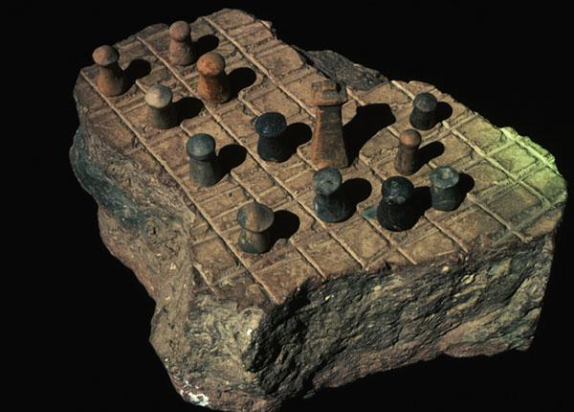
Remains of a board game, Indus Valley Civilization (~3300 B.C.E. to ~1700 B.C.E.), looking similar to ancient version of chess

Slide 14
Chess
The famous game between Pandavas and Kauravas from the era of Mahabharat, which is believed to be happened around ~ 900 B.C.E - ~ 800 B.C.E.
That game played is believed to be Chowka Bhara, A version of Chatur-Anga, which is played as a game of chance by rolling a dice.

Slide 15
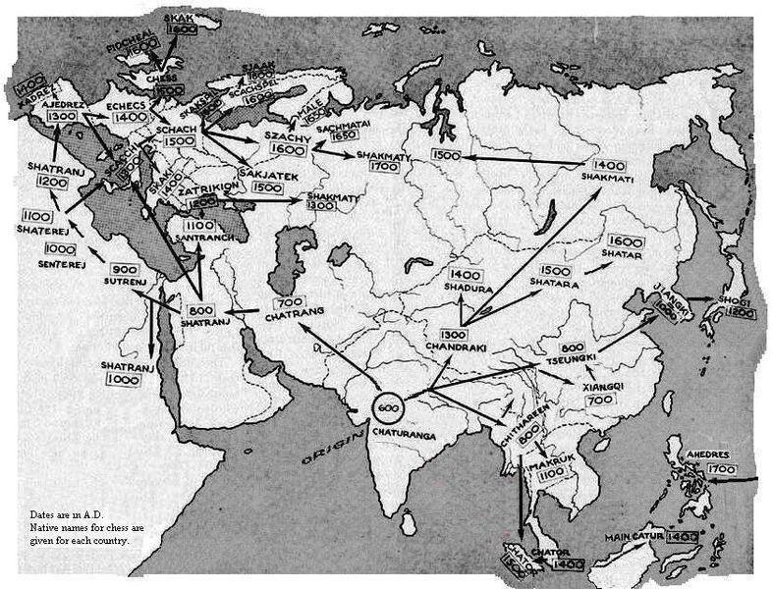
Chatur-Anga (India) → Chatrang (Persia) → Shatranj (Persian Arab Muslims) → Chess (Today)

